Slide 1
INSIGHT INTO A BIKE-SHARE COMPANY
Eshaan Arora
February 6, 2023

Slide 2
Contents
Statement of Purpose
Insights
Conclusion
Appendix

Slide 3
Statement of Purpose
Identify trends that differentiate casual riders from annual members of Cyclistic, to strategize and convert them to members.

Slide 4
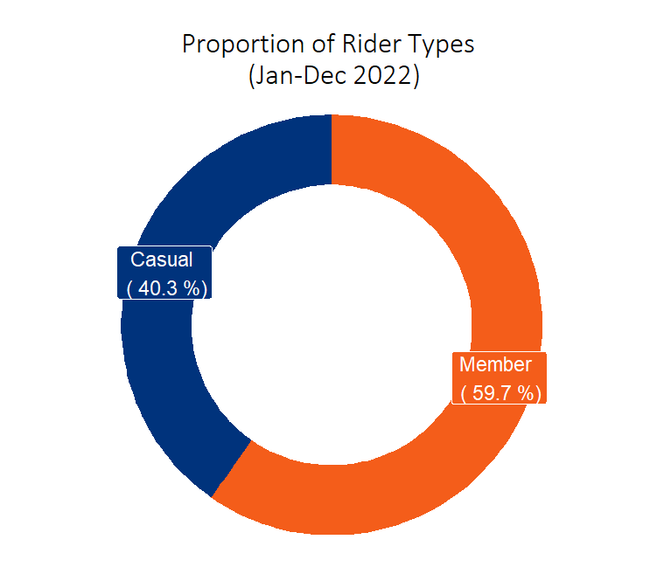
CY 2022- An Overview
Casual riders had lesser proportion than annual members.
Cyclistic aims to reduce it further.
Notes:
Data extracted from the website provided in the Google Data Analytics course’s Capstone Project.
It consisted of each ride’s information (such as bike type used, rider type, start and end stations and timings) for months of Jan to Dec 2022.

Slide 5
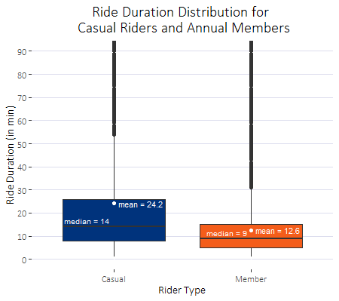
CY 2022- An Overview
Average duration of a trip for a casual rider was nearly double than that of a member.
Range:
Casual (1 min to ~24 days)
Member (1 min to ~1 day)
Median trip duration for casual rider was ~55% more than that for annual member.
Notes:
Average trip duration for casual riders is because of the few outliers that go up to 24 days.
More accurate picture is shown by the median. 50% of the casual riders had trip duration greater than 14 mins, however, only 25% of the annual members showed this behaviour. 75% of annual riders travelled for less than 9 mins.

Slide 6
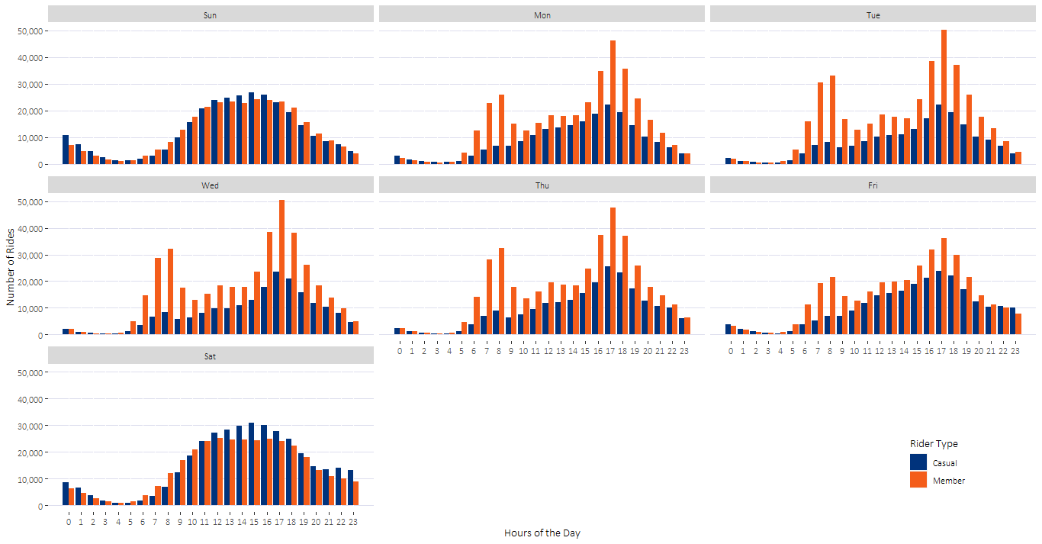
Hour-wise Distribution of Rides
Members usually rode for routine commutes such as travel to work
Casuals tended to ride for leisure
Notes:
Obs 1: Casuals never showed a maxima in the morning hours, they increased till evening everyday and then declined. Members on the other hand, showed a local maxima in the morning at 8 am on weekdays and showed a global maxima in the evening at 5 pm. However, on weekends, members did not show a maxima in the morning and their numbers too declined.
Obs 2: Casuals showed a sharper peak on weekdays at around 5 pm, while they showed a much flatter peak on weekends at around 3 pm. This indicates that they tended to peak at non-working hours.

Slide 7
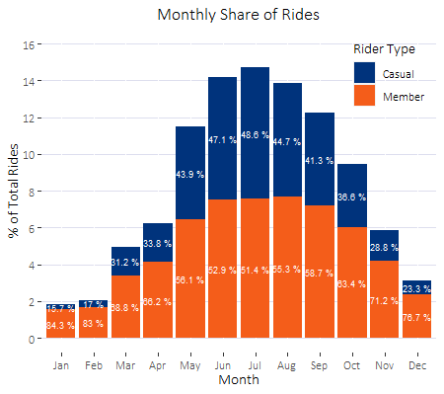
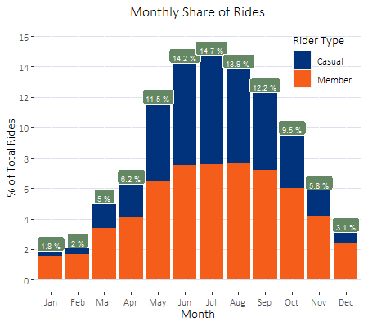
Month-wise Distribution of Rides
During snowy months (Nov to Apr), the ride traffic reduces significantly.
76% of the rides occurred in the warmer months (May to Oct).
Casual riders tend to stop using Cyclistic drastically in the winter months.
Notes:
In winters, outdoor leisure activities become minimal. Only those with routine requirements of commute are likely to ride.
Members also reduce in winter months, but a few routine commuters (like office goers) still remain active.
Therefore, for marketing campaigns that aim towards reducing the proportion of casual riders, warmer months would be more suited.

Slide 8
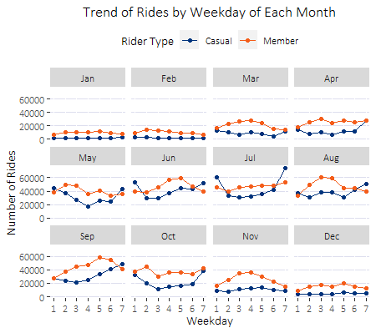
Segregating Months into Weekdays
Number of casual rides tended to cross number of annual rides on Saturdays and Sundays.
Implication- Ratio of casual rides/annual rides is greater than or almost equal to 1 on just weekends
Casual riders tend to use Cyclistic primarily for leisure, during off days from work/school.
Notes:
In graph, 1st weekday is Sunday.

Slide 9
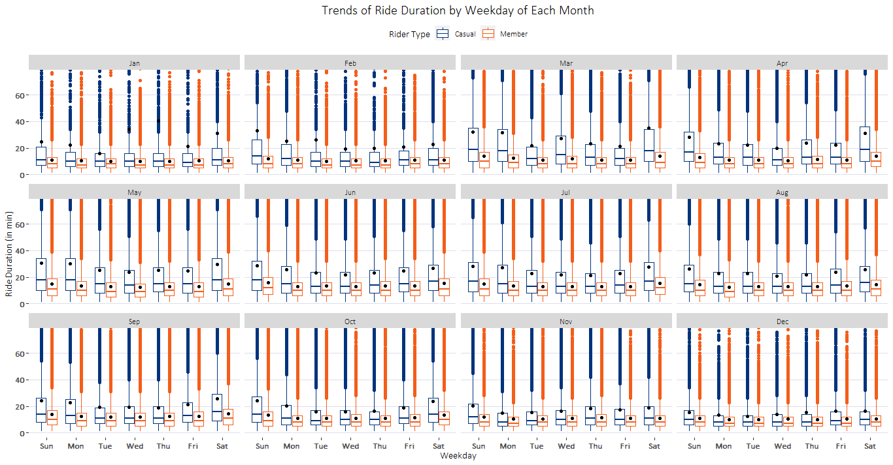
Notes:
Median and average ride durations on each weekday was greater for casual riders.
Also, it is evident that the distribution of ride duration was much less skewed for annual members (since mean is close to median) in all cases. Casual riders, on the other hand, showed high skewness in ride durations.
This implies that casual riders tended to go on much longer rides than annual members.
It peaked on weekends.

Slide 10
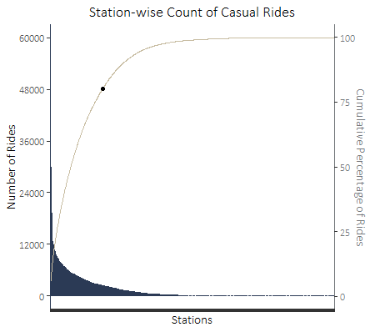
Distribution of Rides Across Stations
Based on Pareto’s Principle of 80-20, the frequency distribution shows that 80% of the total rides (for casual riders) started from roughly 18% of the stations*.
80% of the rides came
from this portion of stations
Notes:
On the X-axis, stations are arranged in decreasing order of number of rides (complete list given in the appendix).
Pareto’s Principle states that 80% of the outcomes come from 20% of the inputs.
Caveat
During cleaning of this data, a few station names consisted the phrase ‘Public Rack’ which was removed. This needs to be confirmed from the business team of Cyclistic.
A complete list of station names with station IDs would also be helpful, as there were a few station IDs which had more than one station names.
This could impact the % of stations to change from 18, but impact would be very less as the number of such cases was of the order of 1000 out of total ~4 million plus rides.

Slide 11
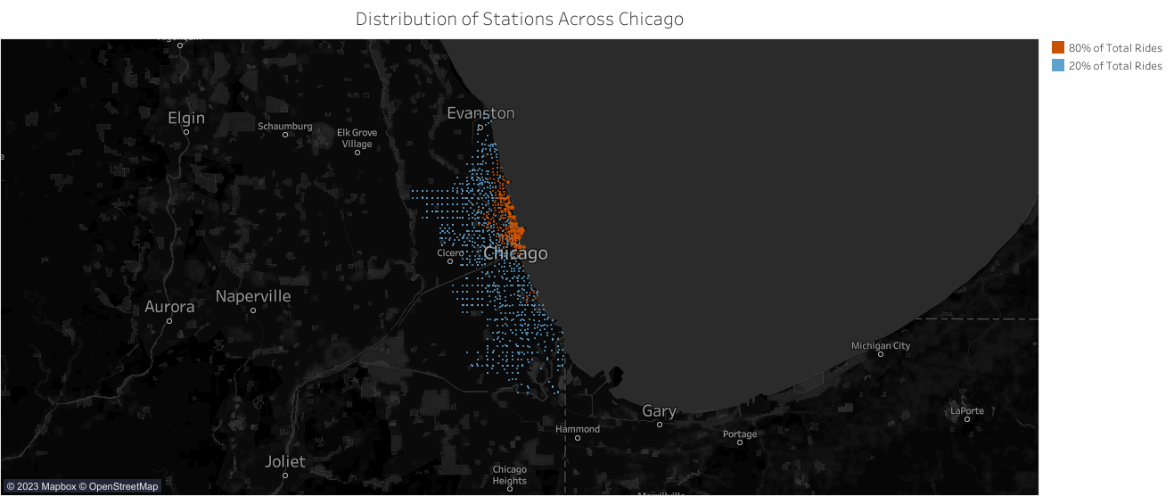
Distribution of Stations Across Chicago
Map for Casual Rides
Notes:
Based on Pareto’s Principle of 80-20, the map shows that 80% of the total rides (for casual riders) started from the stations marked in orange.
Exact number is 236 out of total 1282 stations from were casual rides were initiated. This is roughly 18% of the stations.

Slide 12
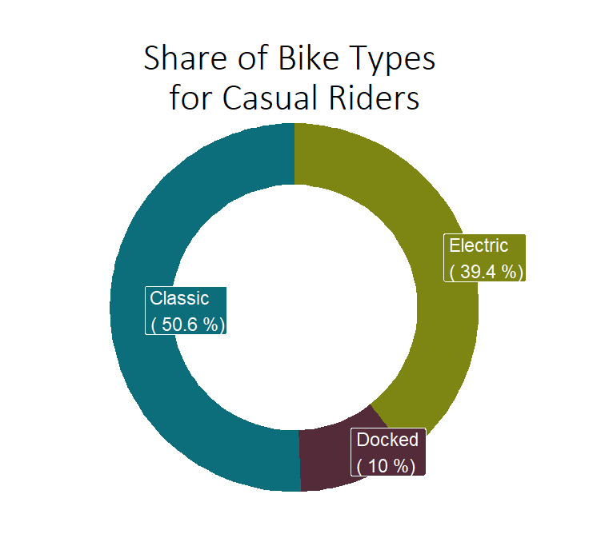
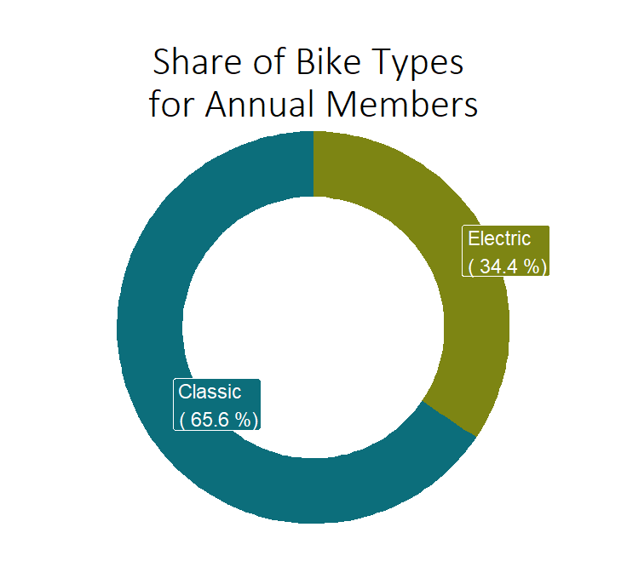
Bike Category- Another Differentiator
Classic bikes were the most popular categories for both rider types.
Docked bikes were never used by annual members, while they represented 1 out of every 10 casual rides.
Notes:
Docked bikes’ first quartile of duration is more than the medians of other bike types for casual riders.
This can be kept in mind that casual riders tend to spend longest duration rides on docked bikes.

Slide 13
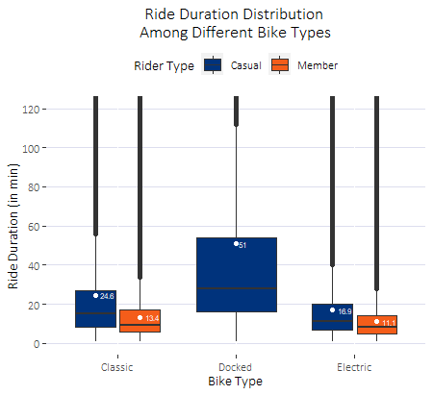
Bike Category- Another Differentiator
It is in line with our previous insight about ride duration that casual members tend to go on longer rides on each bike type.
While docked bikes were the least popular among casual riders, their average and median ride duration were maximum.
Notes:
Docked bikes’ first quartile of duration is more than the medians of other bike types for casual riders.
This can be kept in mind that casual riders tend to spend longest duration rides on docked bikes.

Slide 14
Conclusion
1
Casual riders tend to use Cyclistic bikes for longer durations
Casual riders were active primarily in the summer months and dropped significantly in the winter months
2
Proportion of casual riders peaked on weekends every month
3
18% of the total stations where casual rides started, contributed to 80% of the total rides (stations’ data present in the appendix)
4
Longest duration rides for casual riders came via docked bikes, which were never used by annual riders
5

Slide 15
Conclusion
Marketing campaigns that target casual riders in the top contributing stations, during summer months, leveraging special benefits for weekends and longer durations of rides could be the most effective in converting casual members to annual riders.
Note: More information about distinct riders and distance covered in each ride could lead to more insights.

Slide 16
Appendix
List of stations along with their count of rides and cumulative percentages of rides for casual riders is present in this file

Slide 17
Thank you!
We are open to questions now.

